Slide 1
Guidelines for a Good Presentation
Luis M. Correia
Instituto Superior Técnico / INESC-ID
University of Lisbon, Lisbon, Portugal

Slide 2
Outline
Basic principles.
Structure.
Sizes and contrast.
Style.
Examples.
Conclusions.

Slide 3
Basic Principles (1)
The presentation of a work is intended to show only its major aspects, and not the whole of it.
One should choose the most important results for the presentation.
The presentation should be structured in the same way as the work.
The number of pages should be such that 1 page corresponds to 1 available minute.

Slide 4
Basic Principles (2)
When the audience is composed of a small group of people, a paper copy of the presentation should be distributed to the audience at the beginning.
The format should be of 3 pages of presentation by A4 page, with comment lines on the side.

Slide 5
Structure
The structure should be as follows:
  Cover
  Outline
  Introduction/Motivation/Objectives
  Development ...
  ...
  ...
  ...
  Conclusions

Slide 6
Cover
The cover page should contain (in general):
  the title of the work;
  the names of the authors;
  the institutions to which the authors belong to.

Slide 7
Outline
The outline page should contain the main topics of the presentation.
This list should not be an exhaustive one, but rather just the main global topics.

Slide 8
Introduction/Motivation/ Objectives
Introduction/Motivation/Objectives may occupy 1 to 3 pages, depending on the nature of the work and of the presentation.
Introduction should introduce the area of the work, and how it is placed in a more global perspective.
Motivation should describe the reason why the work is being done.
Objectives should be listed, indicating the key goals of the work.

Slide 9
Development (1)
Development should contain (in general):
  explanation on models/algorithms;
  description of models/algorithms implementation;
  assessment of models/algorithms;
  analysis of results;
  identification of the main results.

Slide 10
Development (2)
Before actually preparing the presentation, it should be structured, by identifying the topics to be addressed, and the general contents of each page.

Slide 11
Sizes and Contrasts
Each page should contain a few short sentences.
Headers should be written in Times New Roman 44 pt (or equivalent).
The text should be written in Times New Roman 32 pt (or equivalent), or slightly lower (28 pt).
The colour of the text should make a clear contrast with the background, in order to make reading easy.
The size of text in equations, tables and figures should be similar to the general one.

Slide 12
Style (1)
The style of the presentation should be coherent and uniform.
One should write complete phrases, with well defined ideas.
One should avoid using acronyms with not well known meaning.
In general, one should not present references from the work.
Do not present very complex equations, with a difficult description.

Slide 13
Style (2)
Each page should contain a specific title related to its contents.
Do not repeat the titles. In case it is needed, include numbering after it, so that they can be differentiated.
Include a reference to the source when using figures from other authors.
This presentation should be used as a template, hence, sizes, dimensions, and so on, should not be changed.

Slide 14
A Bad Example for Text (1)
Data transmission is mostly done in indoor environments.
Outdoor to indoor penetration has a major influence in the data rate available to the user.
A model for performance evaluation of UMTS is required in order to accurately predict this extra attenuation.
A good model would provide an interesting tool for radio network designers.
Coverage and interference need to taken jointly for the estimation of quality.
Coverage has to be established for a given service, i.e., data rate, which is related to capacity
The goal is to study the influence of an indoor environment in the UMTS/HSPA+ data transmission rate, according to different aspects such as:
  building characterisation;
  floor characterisation;
  urban path loss scenario;
  building coverage.

Slide 15
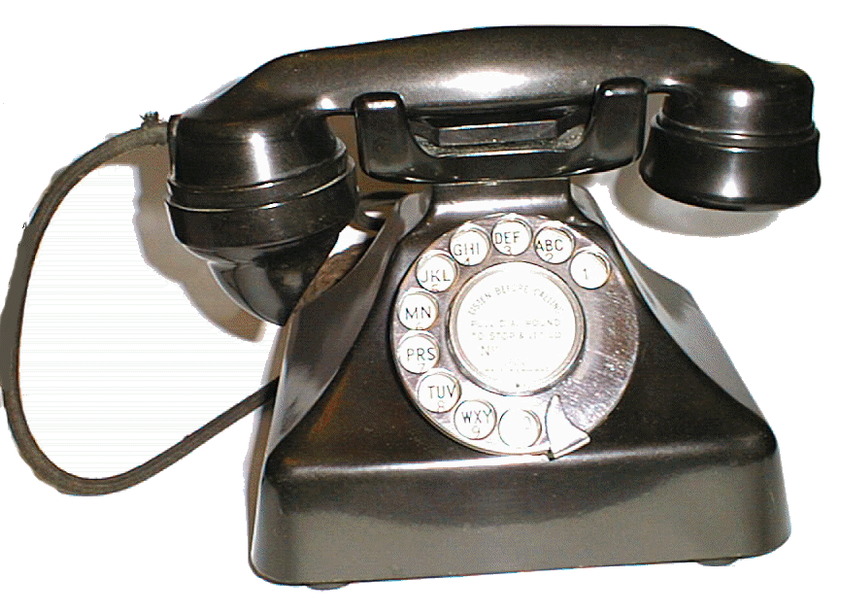
A Bad Example for Text (2)
Data transmission is mostly done in indoor environments.
Outdoor to indoor penetration has a major influence in the data rate available to the user.
A model for performance evaluation of UMTS is required in order to accurately predict this extra attenuation.
A good model would provide an interesting tool for radio network designers

Slide 16
A Good Example for Equations
The problem can be expressed by a Markov chain:
where p(n) is the probability of the system being in state n and

Slide 17
A Bad Example for Equations
The loss can be calculated via one of the following equations:

Slide 18
A Good Example for Tables
System | Launch | Country
NAMTS | 1978 | J
NMT | 1981 | N, S, SF
AMPS | 1983 | USA
C | 1985 | D
TACS | 1985 | UK
R2000 | 1985 | F
RMTS | 1985 | I
GSM | 1991 | EU
PDC | 1995 | J
cdmaOne | 1996 | USA
UMTS | 2002 | EU, J

Slide 19
A Bad Example for Tables

Slide 20
A Good Example for Figures (1)

Slide 21
A Good Example for Figures (2)
There should be a concluding sentence for each figure.

Slide 22
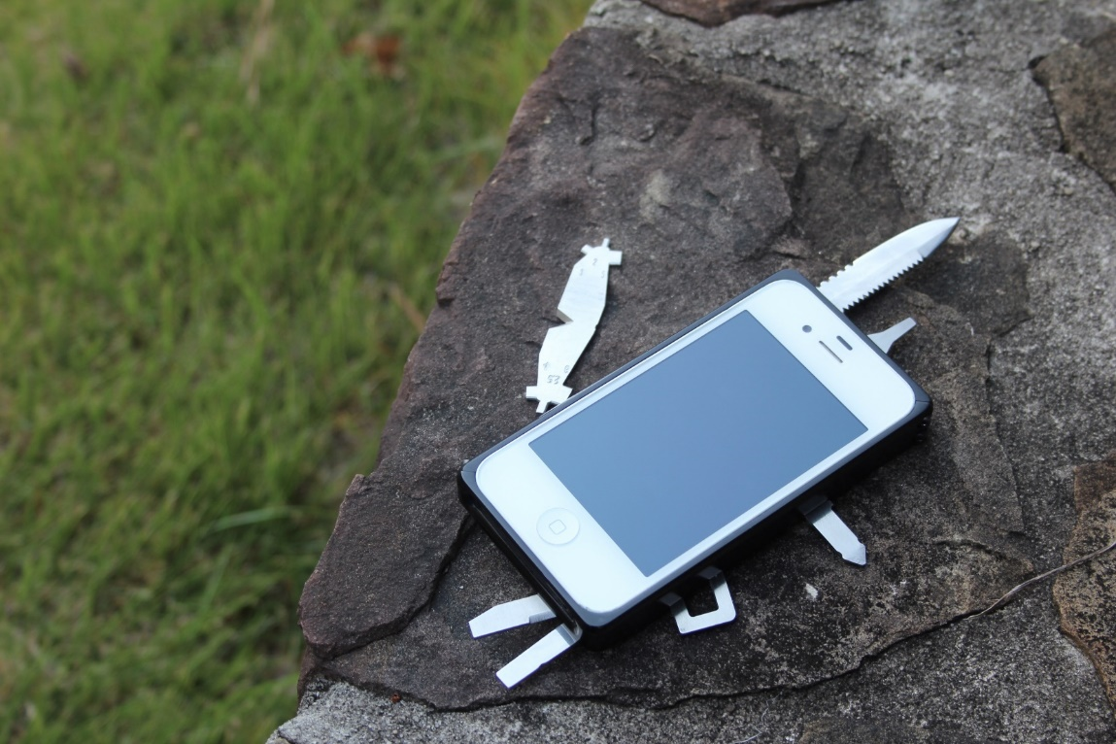
A Good Example for Figures (3)
This is a nice figure.
(TaskOne, 2014)

Slide 23
A Bad Example for Figures
The comparison between theory and measurements shows that the model is reasonable.

Slide 24
Conclusions
This presentation describes some basic principles for a good presentation of a work.
The structure should be similar to the one of the work.
Fonts should be large enough, so that it is easy to read text, graphics, tables, and so on.
Sentences should be short and complete, with well defined ideas.
Each page should correspond to 1 minute presentation.

Slide 25
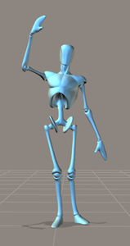
Thank you!
Prof. Luis M. Correia
Tel.: +351-213 100 434
Email: luis.m.correia@tecnico.ulisboa.pt
URL: http://grow.tecnico.ulisboa.pt

